Slide 1

Week 4

Slide 2
Week 4: Contents
Mesh independence study
Post-processing with ParaView
Verification and validation
Course completion
CAD processing – creating you own geometry

Slide 3
Week 4: Prerequisite. How to solve problems?
It is inevitable that participants will run into errors and problems with their project. This is very normal and is expected when building a new OpenFOAM simulation, as it can be a manual process of typing the edits into function files to prepare a new simulation. This slide is to be a guide on how to debug (find errors in the functions) and solving the problems.
Double and triple check the slides. The information on each step to be taken is there.
Read the error message that OpenFOAM gives you in full detail. It typically tells you what the error is and where it is located in your OpenFOAM files.
Check for errors within your OpenFOAM files. Typical errors are forgetting to comment notes with “//”, or only using a single forward slash “/” instead of two for a comment. Another common mistake is forgetting to put a semi-colon “;” at the end of definitions within your OpenFOAM files. A third very common error is having typos in both your Linux terminal or within your OpenFOAM files. The fourth common problem is forgetting to close brackets “{ }” or using the wrong bracket type “{ ) “ paired together.
Search Google, as it is most likely that your question has been answered online previously on one forum or another.
If all the above fails, then post a question on the dedicated LinkedIn support group. Please ensure that your question provides all the relevant detail. If you need to post a question, please search through the LinkedIn group first to see if somebody else has already asked a similar question, which may have been solved. In addition, if you post a question, please ensure that you also attempt to answer a question from another participant, so that we can learn from each other as a community.
If your question does not get answered on the LinkedIn post, email the question to opensourcelearningcfd@gmail.com and the course organizers will reply as soon as possible. We ask for some patience with response times, it may take up to a day for you to receive a reply.

Slide 4
Week 4
Mesh Independence Study

Slide 5
Week 4: Mesh independence study
  Mesh independence (or convergence) studies are done by rerunning the simulation with increasing mesh resolutions until the solution converges to a constant solution. i.e. The solution stays the same even with increasing mesh resolution.
  For the final component of this project, participants must conduct a mesh independence study to evaluate how dependent their results are on the mesh created.
  There are several ways to approach a mesh independence study, and this is typically a rigorous process completed for every new application that a CFD engineer may encounter.
  The mesh can be refined globally (entire volume) or locally (around a location of interest).
  Local mesh independence studies are more commonly conducted than global mesh independence studies due to the prohibitive cost associated with global studies.

Slide 6
Week 4: Mesh independence study
  Participants are recommended to investigate a minimum of 3 meshes and to compare the results.
  Participants are encouraged to simulate additional meshes if they have the time.
  The results can be prepared in a short PowerPoint presentation (or Word document, or any format desired).
  Participants who submit this report will receive a certificate of completion for this project.
  Another study participants can complete is to study the impact of the pitch angle of the lower, or upper, or both wing components, on the lift and drag coefficients of the rear wing.
  Note: this is an extra study that students can complete if they are interested in further study. It is not necessary to complete this to receive the certificate of completion.
  Examples on ways to approach mesh convergence are given in the next slides.

Slide 7
Week 4: Mesh independence study
Example 1
Half the cell length for each subsequent mesh, at the surface of interest. I.e. At the surface of the wing geometry.
This method is suitable for near surface and volume mesh studies.
The number of cells using this method gets exponentially larger.
Mesh 1
Mesh 2
Mesh 3
Cell
Cell
Cell
2 cm
1 cm
0.5 cm
Surface of geometry

Slide 8
Week 4: Mesh independence study
Example 2
Incrementally decrease the cell size at the location of interest. E.g. Your largest cell size on the surface of the wing might be 5 cm. You might then test cell sizes of 4 cm, 3 cm, 2 cm, and 1 cm.
This method is applicable for both near surface and volume mesh studies.
The number of cells using this method increases gradually.
Mesh 1
Mesh 2
Mesh 3
Cell
Cell
Cell
Cell
5 cm
4 cm
3 cm
Surface of geometry

Slide 9
Week 4: Mesh independence study
Example 3
Prism layers can be used to resolve the boundary layer.
The number of layers used, coupled with the thickness of the first layer and subsequent expansion ratio, means that several studies can be required to determine the impact of resolving the boundary layer on your overall result.
Having a high number of layers ( > 15 ) can significantly increase the number of cells in your mesh, and thus, increases the computational expense of your simulation.
Thin prism cell extruded from surface triangle
Final layer thickness is typically set as a percentage of the height of the surrounding cells outside of the prism layers.
Near wall velocity boundary layer
Cell
Additional layers can be set by an expansion ratio.
E.g. The 2nd cell will have a height of “first layer thickness x expansion ratio”.
Surface of geometry
First layer thickness
Surface triangle

Slide 10

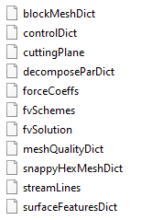
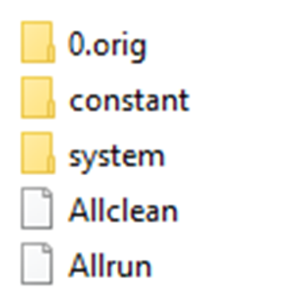
Week 4: Mesh independence study
  The steps below detail how to complete the mesh independence study.
  Make a copy of the RearWingSimulation directory.
  Note: ensure the simulation has run successfully (without errors) before making a copy of the directory.
Original Rear Wing simulation directory
Copy of the Rear Wing simulation directory for the mesh independence study
  Update the mesh by editing snappyHexMeshDict.
  Refer to the Week 2 slides for details on the snappyHexMeshDict file.

Slide 11

Week 4: Mesh independence study
  Participants are free to choose the mesh settings themselves.
  If participants are very unsure about what mesh sizes to use, it is recommended to pick a large cell size at the surface of the geometry, and to continue halving that cell size for each subsequent mesh.
  Once you have updated the mesh, open the OpenFOAM terminal and move into the directory for your mesh study.
  Delete the previous mesh files or run “Allclean” to remove the files.
  Remesh the geometry following the procedure from Week 2.

Slide 12
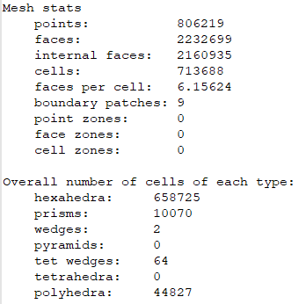
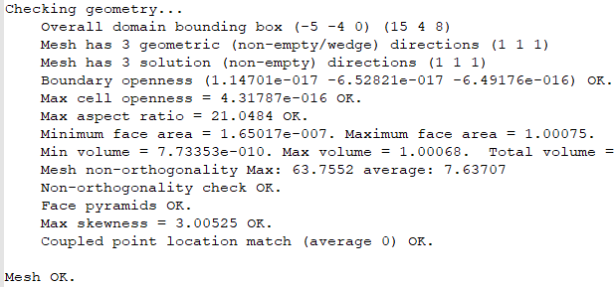
Week 4: Mesh independence study
  Tip
  Use the command “checkMesh” in the terminal to get information on the number of cells you have within your mesh.
  Use “checkMesh > log_CheckMesh” to write this information to a file called “log_CheckMesh”.
  Note: it is recommended to visually inspect each new mesh in ParaView, to check that the changes inputted into snappyHexMesh or blockMesh were successful and that the resultant mesh is as expected.
  The solution from “checkMesh” is shown below.
Total number of cells
Breakdown of cells by type
The final message within “checkMesh” is a verification of whether the quality of your mesh is sufficient for a simulation.

Slide 13
Week 4: Mesh independence study
  Rerun the simulation using “potentialFoam” and “simpleFoam”.
  Ensure that the residuals are converged for each simulation.
    A max value of 1e-05 across all conserved variables should be considered as converged.
Compare lift and drag coefficients.
  Create a chart (in Excel for example) of the number of cells vs. lift coefficient, and the number of cells vs drag coefficient.
Using ParaView, create images of surface pressure, and plane slices of pressure and velocity, and compare these images between each run to gain an understanding of the physics of what is happening, and why you get your resulting drag and lift coefficient differences.
More information is given in the section “post-processing with ParaView”.

Slide 14
Week 4: Mesh independence study
  Grid Convergence
  The following link to a NASA website provides more information on how users can estimate grid convergence (mesh convergence).
  https://www.grc.nasa.gov/www/wind/valid/tutorial/spatconv.html#:~:text=Grid%20Convergence%20Index%20(GCI)&text=The%20GCI%20can%20be%20computed,the%20asymptotic%20range%20of%20convergence
  It is highly recommended that participants read through this site, and attempt to perform the calculations from their own meshes.
  In particular, participants are recommended to try and calculate the GCI (Grid Convergence Index) for their mesh convergence study.
  A GCI is essentially an error band on the grid convergence level achieved and is a consistent method for reporting grid convergence levels.
  A fully worked out example and an explanation is provided at the link above, and thus, it won’t be discussed within the current slides.

Slide 15
Week 4: Mesh independence study
Presentation of results
A graph of the number of cells in the mesh vs. a measured quantity within the simulation, such as drag or lift force, is commonly used to present the results of a mesh convergence study.
See the following image as an example.
The drag coefficient should converge towards an asymptote with increasing number of cells
Mesh 4
Mesh 5
Drag coefficient value
Mesh 3
Mesh 2
Mesh 1
Number of Cells

Slide 16
Week 4
Post-processing with ParaView

Slide 17
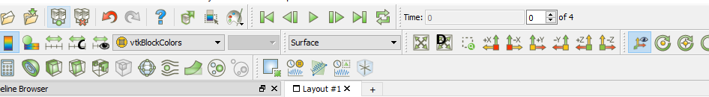
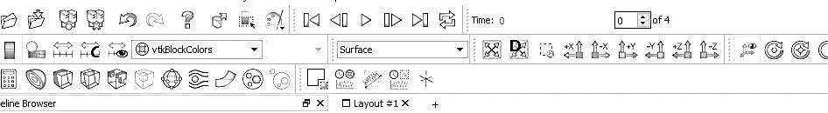
Week 4: ParaView post processing
  Open the results in ParaView using the “paraFoam” command or by using the “Open” menu in ParaView.
  A cutting plane can be created in ParaView using the slice tool, as shown below.
Ensure you select the latest time possible, to view the latest data output from OpenFOAM.
Select the “Slice” tool to create a cutting plane.

Slide 18
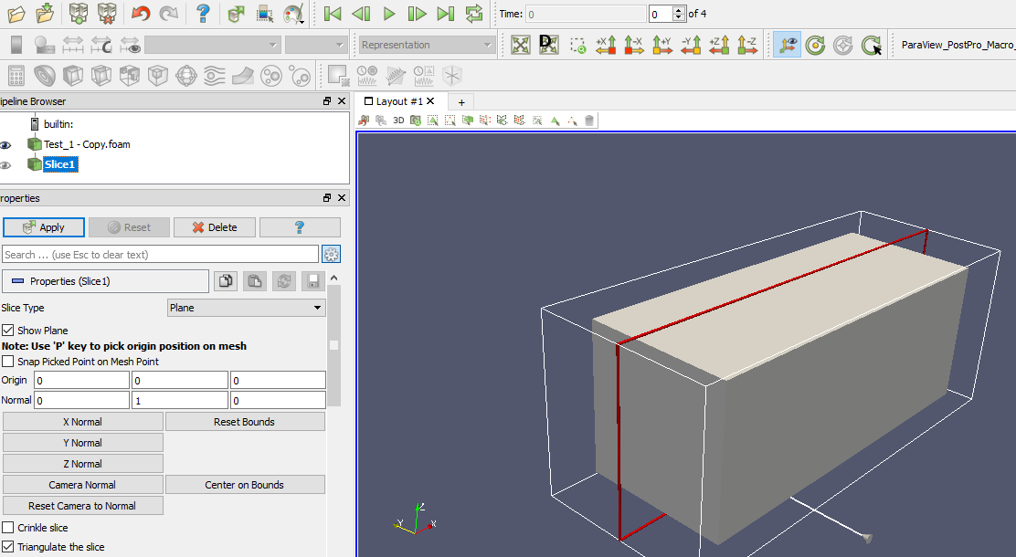
Week 4: ParaView post processing
Create a plane normal to the y axis, centered at (0 0 0).
Centered at (0 0 0)
Parallel to y axis

Slide 19
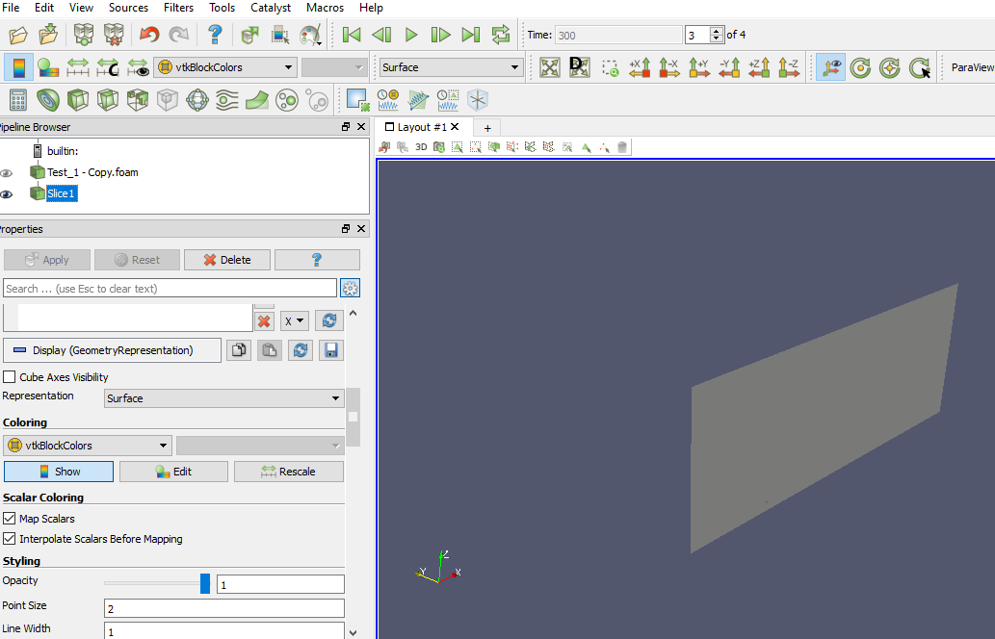
Week 4: ParaView post processing
Change the representation to “Surface & Edges” to visualise the mesh on the plane, or on the Rear Wing surfaces.
Change the colouring of the slice from “vtkBlockColours” to either pressure (p) or velocity (u).

Slide 20
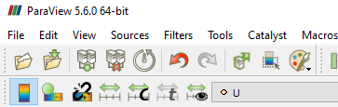
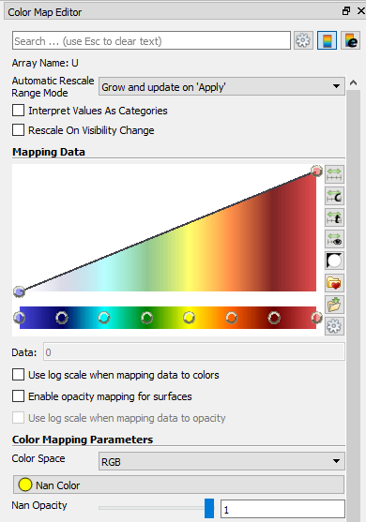
Week 4: ParaView post processing
  Select the “Edit Color Map” button to open the Colour map Editor.
  The Colour map Editor will appear as a side menu.

Slide 21
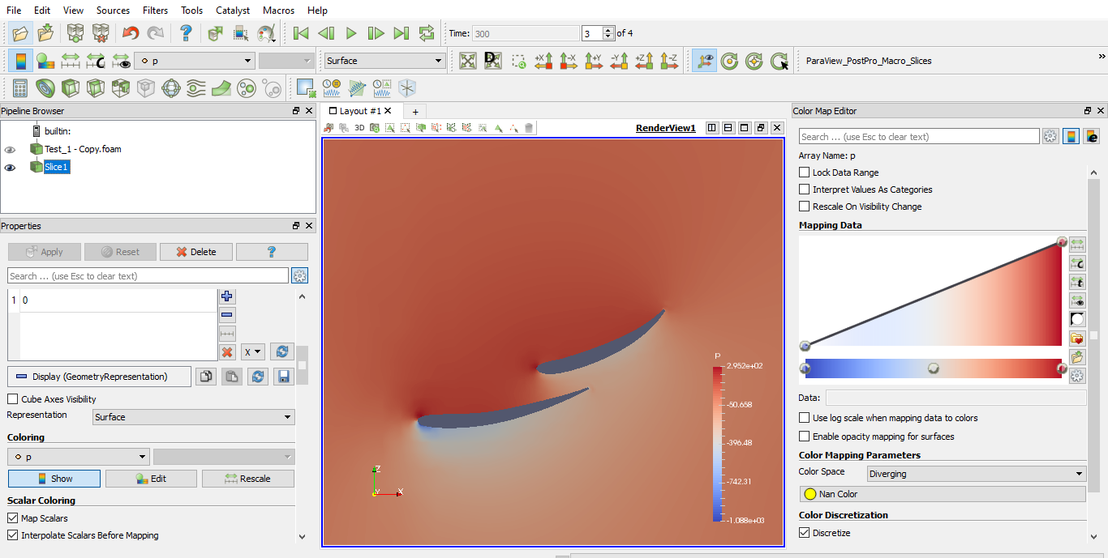
Week 4: ParaView post processing
  Select “choose pre-set” to select a different colour map.
choose pre-set

Slide 22
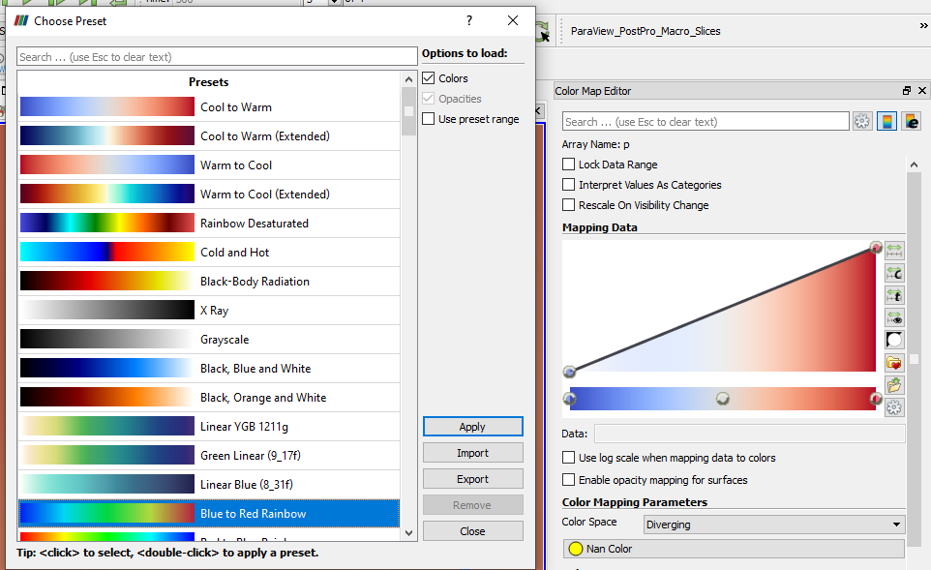
Week 4: ParaView post processing
Blue to Red rainbow is a commonly used and easy to interpret colour map.
Select this colour map and select the “Apply” button.

Slide 23
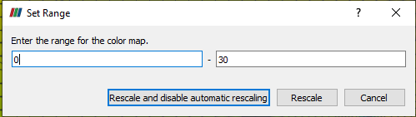
Week 4: ParaView post processing
  Select the “Rescale to Custom Data Range” button to edit the range of values being displayed.
  For pressure, display between a min and max of -300 and +300 Pa.
  For Velocity, display between 0 and 30 m/s.
  Select the “Rescale” button to set the new scale.

Slide 24


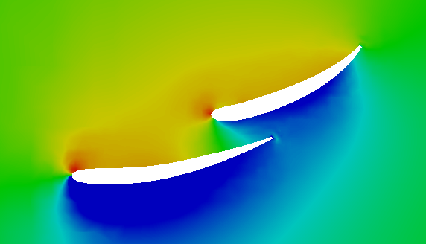
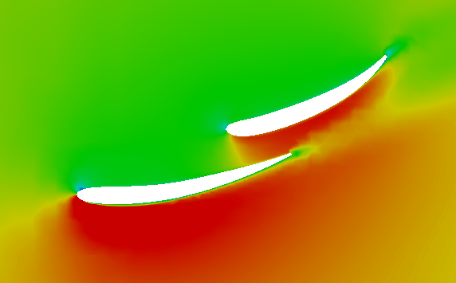
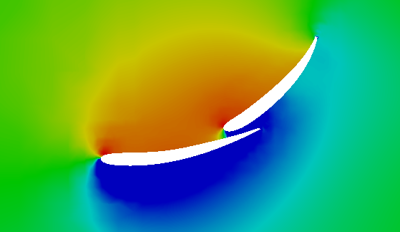
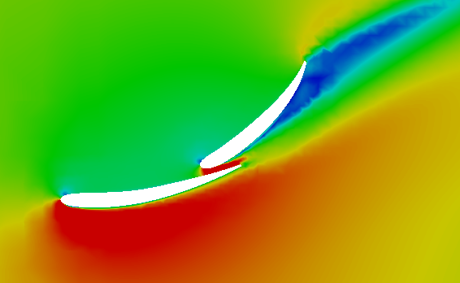
Week 4: ParaView post processing
  This slide provides an example comparison of the rear wing with a nominal pitch angle (i.e. the original angle) and a second test where the upper element has been rotated about its center of gravity by 20 degrees anti-clockwise.
  Pressure and velocity plots are compared here.
  Lift and drag coefficients are compared in the table.
  Note: these were run from coarse simulations and are not highly accurate simulations.
Pressure plots
Velocity plots
Pressure (pa)
Velocity Magnitude (m/s)
Nominal
Nominal
+20°
+20°
Variant | C_{D} [-] | C_{L} [-]
Nominal angle | 0.570 | -1.925
+20° pitch | 0.735 | -1.924

Slide 25
Week 4: ParaView post processing
Pressure plots
Velocity plots
Pressure (pa)
Velocity Magnitude (m/s)
  With this particular comparison, we see that with the increased pitch angle we get a higher drag and a slightly lower downforce (i.e. negative lift).
  Try to interpret the pressure and velocity plots to understand why this is the case.
  Questions on this can be answered at the end of the week.
Nominal
Nominal
+20°
+20°
Variant | C_{D} [-] | C_{L} [-]
Nominal angle | 0.570 | -1.925
+20° pitch | 0.735 | -1.924

Slide 26
Week 4
Verification and Validation

Slide 27
Week 4: Verification and validation
  Verification
  Verification determines if the implementation of the simulation is correct. I.e. that the mathematics in the model meet analytical results and the assessment of programming and user errors.
  Typical verification studies include (but are not limited to) mesh independence studies and monitoring the impact of residual levels and mass imbalances within the simulation.
  Validation
  Validation determines if the results from the simulation agree to those of the physical world. I.e. it is a comparison of the numerical solution to experimental results.
  No simulation can be considered as physically accurate until it is thoroughly validated against experimental results.
  Wind tunnels are typically used to validate aerodynamics-based CFD simulations, using force measurements, pressure taps, velocity probes, and visual methods such as PIV (Particle Image Velocimetry).
  All participants are advised to be extremely critical of CFD results that are not thoroughly validated.

Slide 28
Week 4: Verification and validation
  Additional information on verification and validation of CFD simulations can be found at the following links:
    NASA:
    https://www.grc.nasa.gov/WWW/wind/valid/tutorial/tutorial.html
    University of Southhampton:
    http://www.southampton.ac.uk/~nwb/lectures/GoodPracticeCFD/Articles/Validation_SAND2002-0529.pdf
    University of Iowa:
    http://www.simman2008.dk/PDF/iihr_407.pdf

Slide 29
Week 4
Course Completion

Slide 30
Congratulations for reaching the end of this project!
Good luck with your mesh independence study. Submit your results via a short report
(2 slides/pages max) to receive a certificate of completion.
Any feedback on this project is most welcome.

Slide 31
Voluntary charity donations
If participants enjoyed the course, and would like to contribute back to society, we can recommend a number of charities for voluntary donations.
The Olive Branch for Children: The Olive Branch is a grassroots organization that focus on HIV/AIDS prevention and care, early childhood education, food security, environmental issues, gender equality, and vulnerable children and women. Their goal is to establish community-led programs which empower remote communities and generate models that can be replicated in communities throughout Tanzania and elsewhere. https://www.theolivebranchforchildren.org/make-a-donation
Black British Professionals in STEM: BBSTEM promote, encourage, and enable individuals within industry and education to widen the participation and contribution of Black individuals in STEM.
https://bbstem.co.uk/donations/
National Girls Collaborative Project: The National Girls Collaborative Project encourages and promotes girls to pursue careers in STEM subjects; Science, Technology, Engineering, and Mathematics.
https://ngcproject.org/

Slide 32
How to continue learning?
There are many steps that participants of this course can take to continue learning OpenFOAM by themselves.
Explore all the links to external material within the slides. There is a wealth of information available on the internet, and these links will bring you to the most relevant and useful sites for each topic.
Read up on “fvSchemes” and try running the Rear Wing simulations with 2nd order schemes instead of 1st order. Try to understand the difference between 1st and 2nd order accurate simulations
Explore turbulence modelling and try running Rear Wing simulations with different turbulence models. Maybe start with the standard k-epsilon model. Note the differences in the results (flow field and aerodynamic forces) and consult the literature as to why the results might be so different.
Try running transient simulations using the “pimpleFoam” solver within OpenFOAM.
Try creating your own unique geometry and simulating it in OpenFOAM. There are open-source CAD softwares available. Salome Mecca (comes with Code-Aster) is a free open-source CAD software that can be used to create your own unique geometry and can be used to adjust the pitch angle of the wing elements on the Rear Wing geometry: https://code-aster-windows.com/download/. There are several tutorials available on YouTube to get aid in getting started.
Using the present “Rear Wing” geometry, try adjusting the pitch angle of the wing elements, and simulate it to evaluate its impact on the lift and drag coefficients. Can you find the optimal angle by conducting a study investigating several variations in pitch angle?

Slide 33
Week 4 additional material, how to continue learning:
CAD processing – Creating & testing your own geometry

Slide 34
CAD processing
The following tips are for creating and testing your own geometry:
Different components of your CAD model may require different names (called PID’s, Property ID’s), depending on how you want to post-process the results. For example, if you have a rear wing, you might want each separated wing component to have a separate PID, along with the endplates, and any mounts.
This allows you to break down the forces on each component of your CAD model.
It is recommended that each PID’d part is a solid body that intersects with each other.
Each of the CAD parts must be converted to a surface mesh, in .stl or .obj format.
It is recommended to use .stl format in ASCAII format, so that it can be editable in Notepad++.
Ensure you update the necessary OpenFOAM files so that all your new PID names are accounted for within the simulation.

Slide 35
CAD processing
Further tips for creating your own CAD and mesh files:
Clean CAD is required when preparing CFD simulations. That means no small holes that cannot be resolved sufficiently by the mesh, no split surfaces, no narrow gaps.
Ensure that your CAD model is located in a sensible position with regards to the point of origin in the model (0 0 0).
This is so you can place the inlet, outlet, ground and side boundary conditions of a virtual wind tunnel environment in the CFD simulation around you’re model with ease.
Typically, the ground is at z = 0, and the center of the model geometry is located somewhere around x = 0 and y = 0.
Salome Mecca can be used to scale or re-orientate your .stl surface meshes, if the CAD was not created in the desired location.
There are also surface re-mesh tools, and small gaps/holes can be fixed.

Slide 36
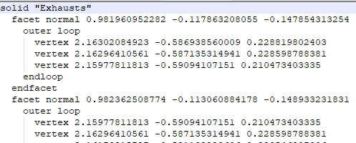
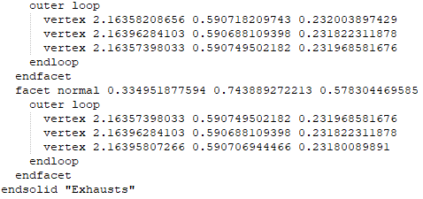
CAD processing
To apply your PID names to each of your .stl surface mesh files:
Open your .stl mesh files in Notepad++.
Note: they must have been saved in Ascaii format, not binary.
At the top of the file, solid “PID name” is required. In this example, the PID name is “Exhausts”.
At the bottom of the file, endsolid “PID name” is required. In this example, the PID name is “Exhausts”.

